Slide 1




User
WAN
Data Center
Fraction in WAN
Fraction in DC
eNode-B
WAN
test point
hotspot
(USB)
Cellular Backbone
AT&T Backbone

Slide 2
Resolve:
qid.myAddr.mydomain.com
Resolve:
qid.myAddr.mydomain.com
myAddr
1
ns.target1.com
(target 1)
ns.target2.com
(target 2)
DNS Client
6
8
NXDomain
Referral:
ns.target2.com
DNS Server
5
NXDomain
4
7
Resolve:
qid.myAddr.mydomain.com
2
Resolve:
qid.myAddr.mydomain.com
ns.mydomain.com
Referral:
myAddr
5
8
Record time delta T between and
Determine RTT between myAddr and target1
Latency target1 to target2 = T – RTT
the time between and
3
6
7

Slide 3
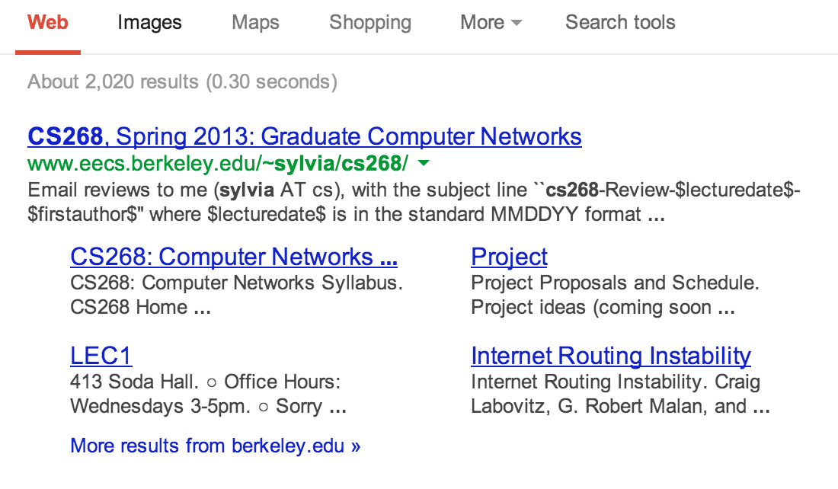

Slide 4

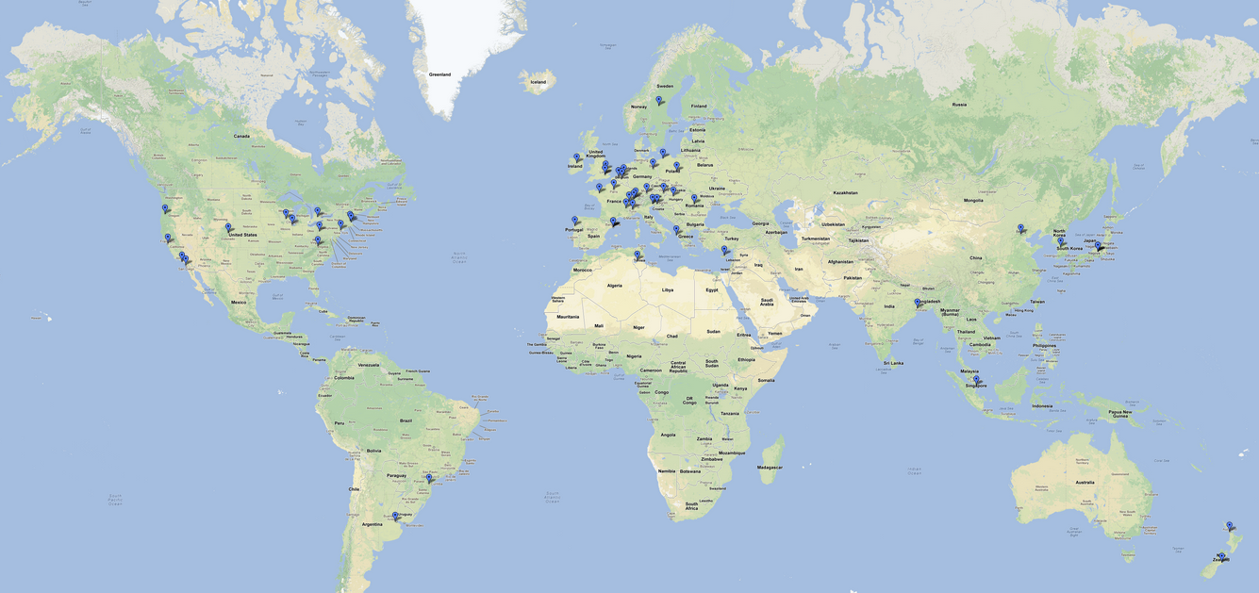

Slide 5
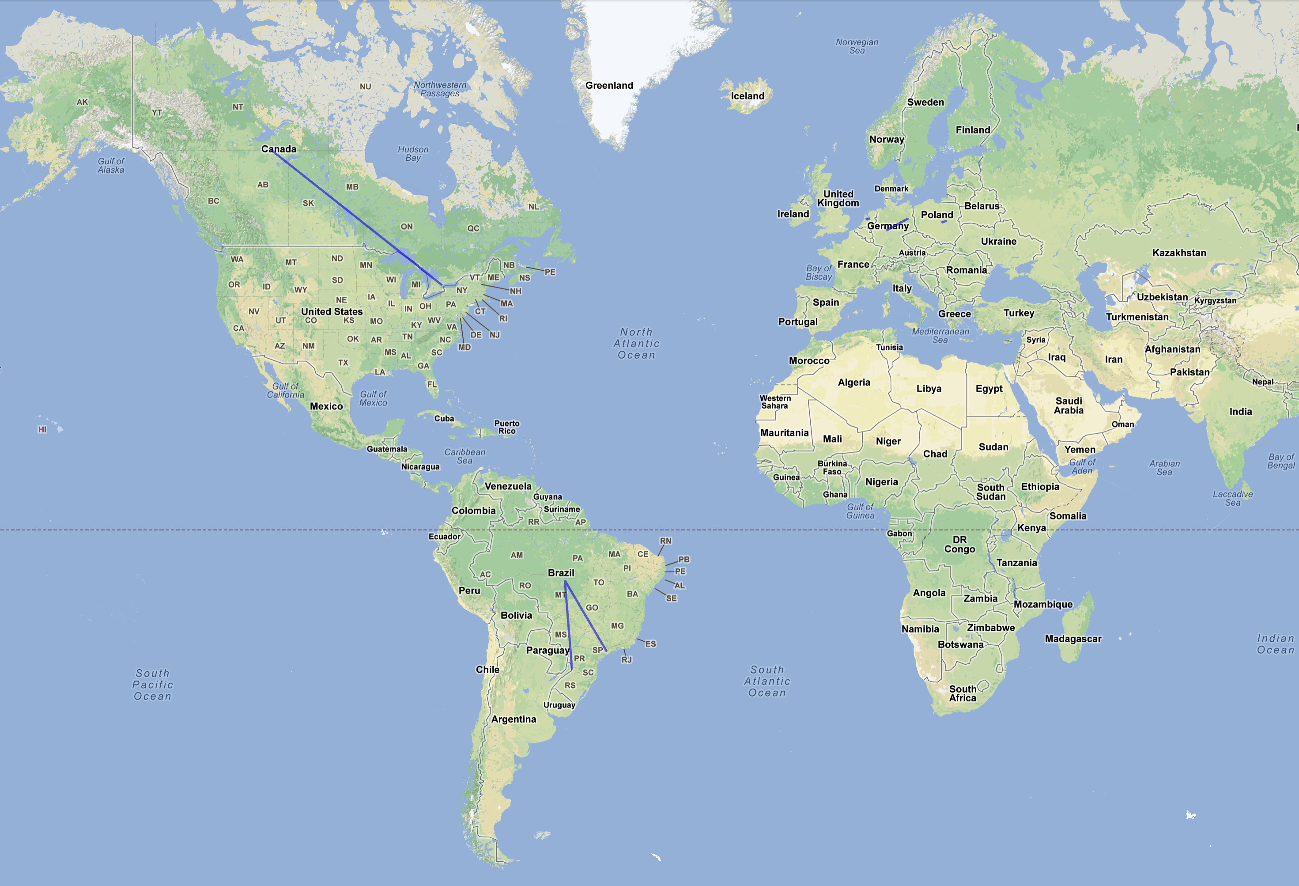
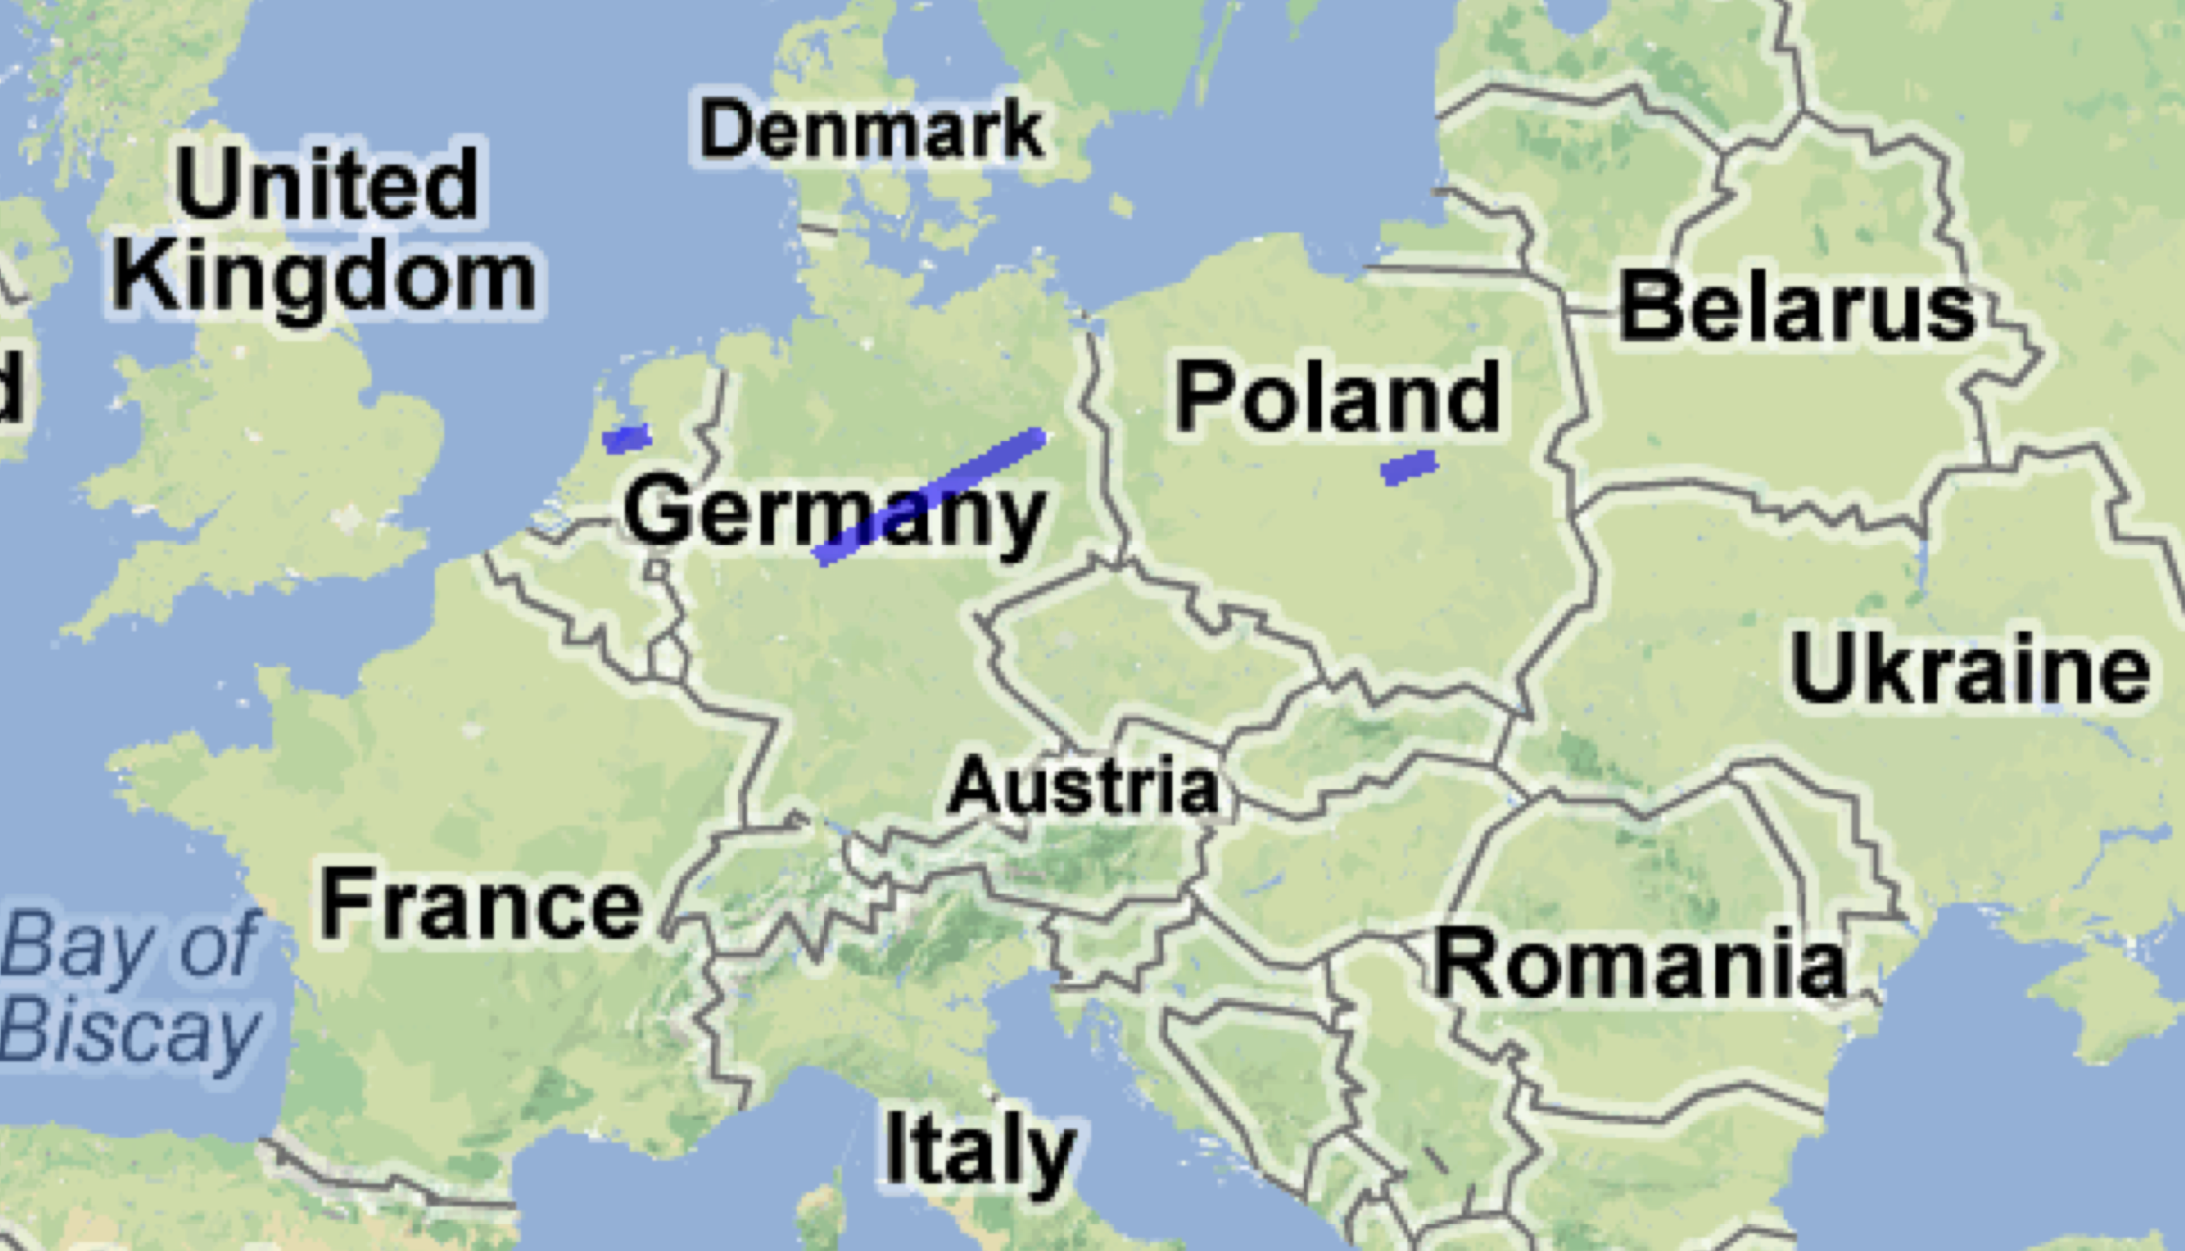
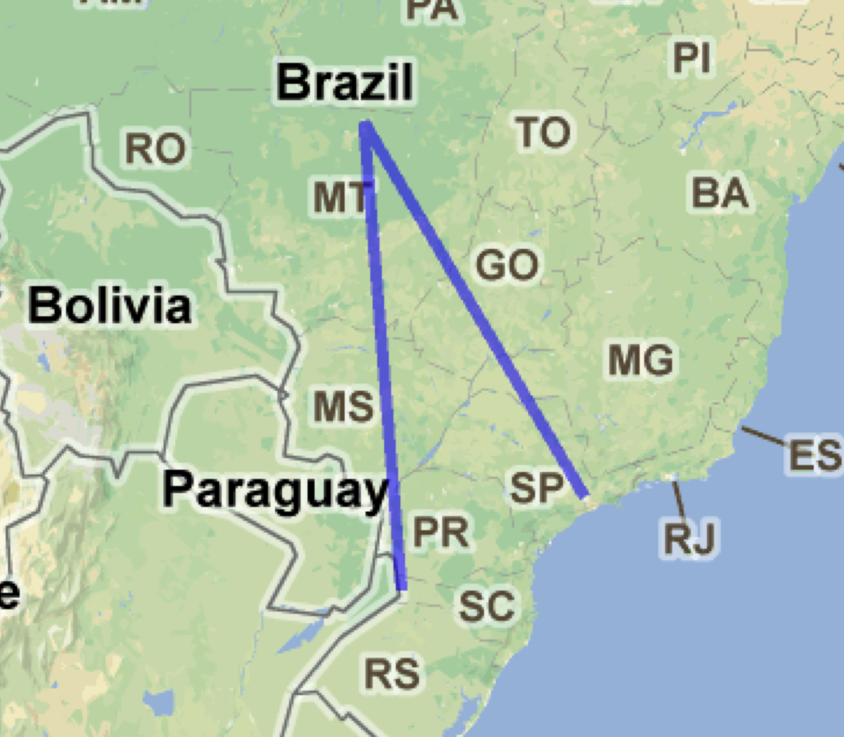

Slide 6
traceroute: Warning: google.com has multiple addresses; using 74.125.224.102
traceroute to google.com (74.125.224.102), 13 hops max, 52 byte packets
1 [AS0] 172.20.10.1 (172.20.10.1) 0.931 ms 0.641 ms 0.640 ms
2 [AS16509] 172.26.241.113 (172.26.241.113) 29.237 ms 40.488 ms 30.427 ms
3 [AS16509] 172.26.236.2 (172.26.236.2) 30.465 ms 39.311 ms 32.393 ms
4 [AS0] 172.26.96.2 (172.26.96.2) 30.292 ms 40.567 ms 31.284 ms
5 [AS0] 172.26.96.193 (172.26.96.193) 30.455 ms 39.341 ms 32.492 ms
6 [AS0] 172.16.121.113 (172.16.121.113) 30.324 ms 31.025 ms 31.280 ms
7 [AS7018] 12.249.2.49 (12.249.2.49) 38.174 ms 45.724 ms 31.341 ms
8 [AS7018] 12.83.180.82 (12.83.180.82) 29.585 ms 52.117 ms 35.297 ms
9 [AS7018] cr81.sj2ca.ip.att.net (12.122.1.118) 39.171 ms 43.577 ms 35.397 ms
10 [AS7018] 12.122.114.21 (12.122.114.21) 35.391 ms 42.340 ms 31.162 ms
11 [AS7018] 12.249.231.14 (12.249.231.14) 31.498 ms 43.073 ms 32.525 ms
12 [AS15169] 209.85.249.3 (209.85.249.3) 29.350 ms 44.505 ms 30.367 ms
13 [AS15169] 64.233.174.109 (64.233.174.109) 31.474 ms 31.830 ms 30.431 ms

Slide 7
client
Google
10:19:22.752
SYN
SYN+ACK
10:19:22.758
ACK
PUSH, HTTP GET
10:19:22.764
10:19:22.811
~0.879 seconds
TCP time:
0.541 seconds
Additional overhead
introduced by python,
IO, and DNS lookup
DATA+ACK
~0.346 seconds
Google Time:
0.30 seconds
DATA, PUSH
10:19:22.922
ACK
10:19:23.104
DATA+ACK
FIN, PUSH
10:19:23.288
ACK
ACK
FIN
10:19:23.293

